Slide 1

CS302 Design and Analysis of Algorithms
Muhammad sohail afzal

Slide 2
Binary Search Algorithm
Given a sorted array of integers and a target value, find out if target exists in the array or not
Input: arr[] = {3,4,6,7}, target = 4
Output: Target is in index 2 (if index starts from 1)
Trivial/Simple Solution: Simple solution is “Linear Search” which will check every element of array to find the required element and hence O(n) complexity. But “Binary search algorithm” does it in Log(n) time by recursively breaking it.
Binary search precondition is array should be sorted

Slide 3
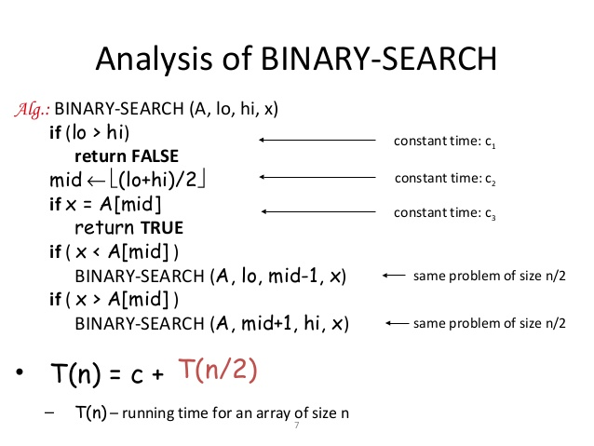
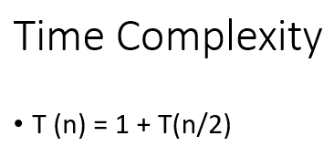

Binary Search Algorithm
Sometimes considered as divide
and conquer algorithm
Best case time would be O(1) when
element to be found is present in middle

Slide 4
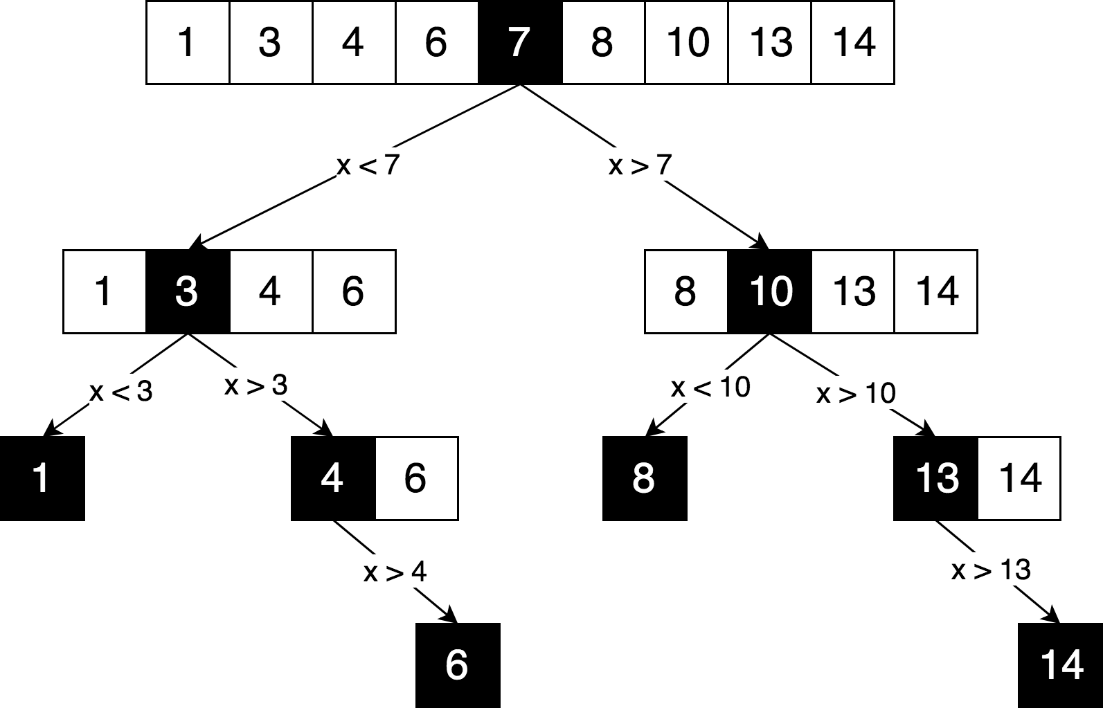
Binary Search Algorithm

Slide 5
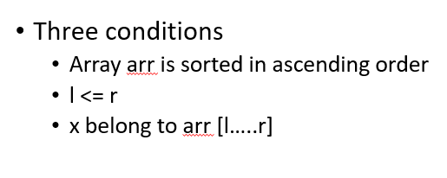
Binary Search Algorithm
Loop invariant of Binary Search :
Here l = lo = index of left most element
Here r= hi = index of right most element

Slide 6
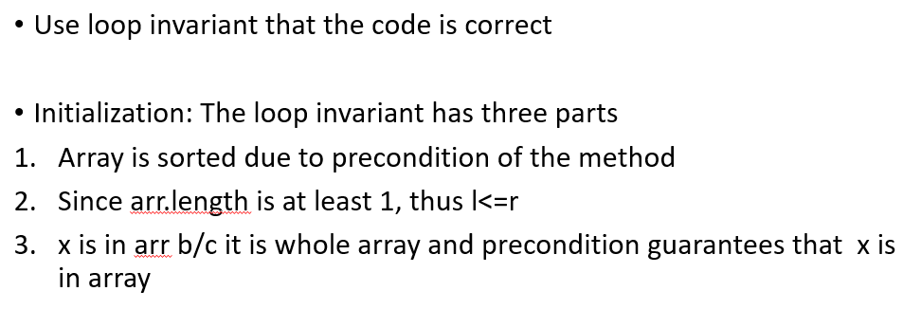
Binary Search Algorithm

Slide 7
Binary Search Algorithm
Maintenance :
1. Array order is never changed so first point holds. It is sorted.
2 & 3. Think it yourself. Try to convince that there could be three possibilities. Number belongs to mid element index or in the left part or in the right part. But where ever it is, l<=r will hold. And number will belong to any of the three parts which means that x belongs to array[l….r]

Slide 8
Binary Search Algorithm
Termination :
Think it yourself. Assuming the loop invariant holds at the start of each iteration, show that some quantity (index) strictly decreases, and that it cannot decrease indefinitely without making the loop invariant false.

Slide 9
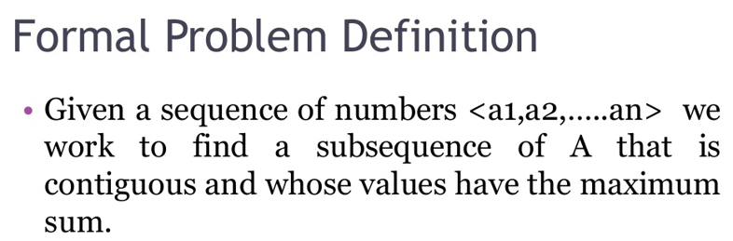
Maximum Sub Array Problem

Slide 10
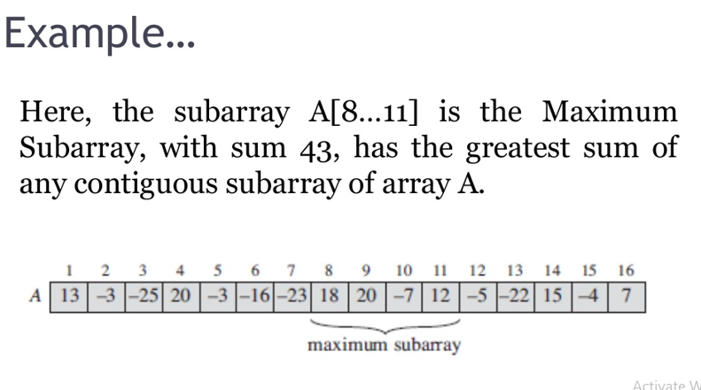
Maximum Sub Array Problem

Slide 11
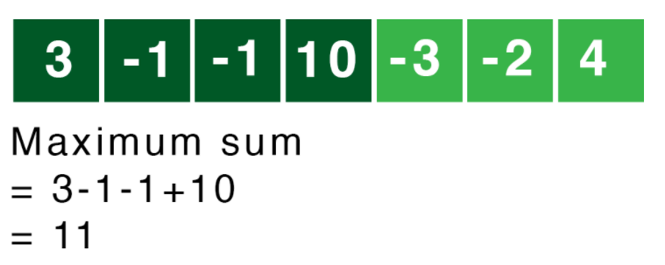
Maximum Sub Array Problem
Another Example :

Slide 12
Maximum Sub Array Problem
Applications :
1) To find the brightest part of image in computer vision
2) To maximize the profit through purchase and sale of stocks
and many others..

Slide 13
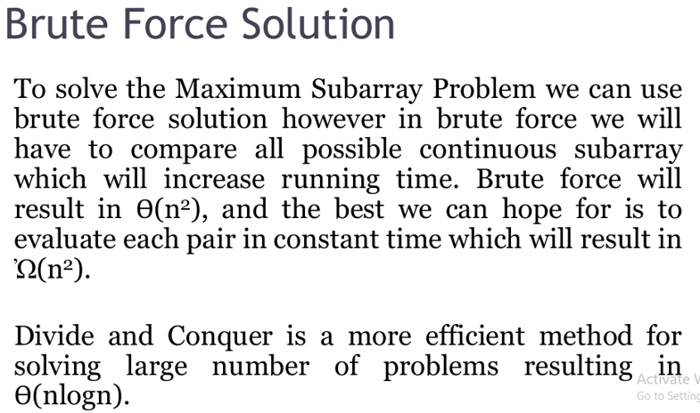
Maximum Sub Array Problem

Slide 14
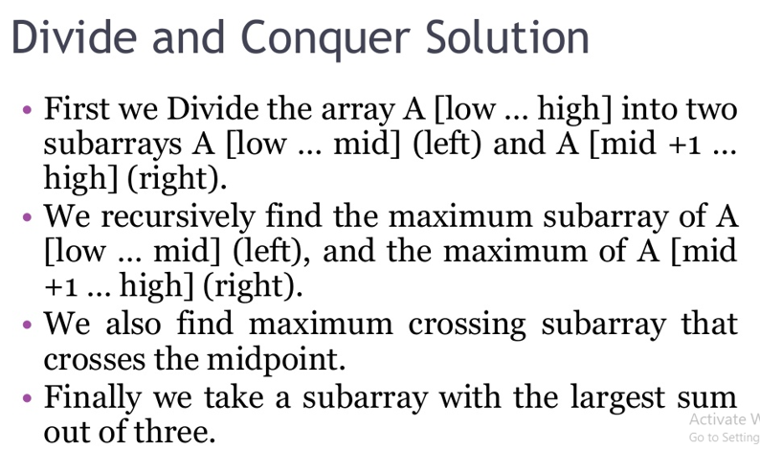
Maximum Sub Array Problem

Slide 15
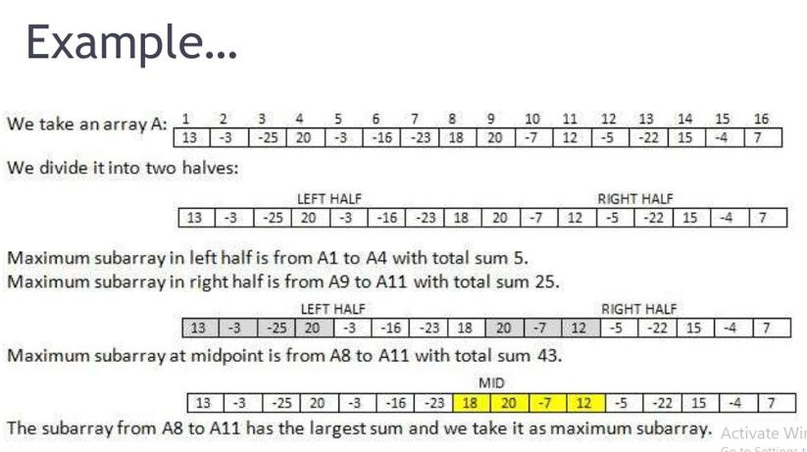
Maximum Sub Array Problem

Slide 16
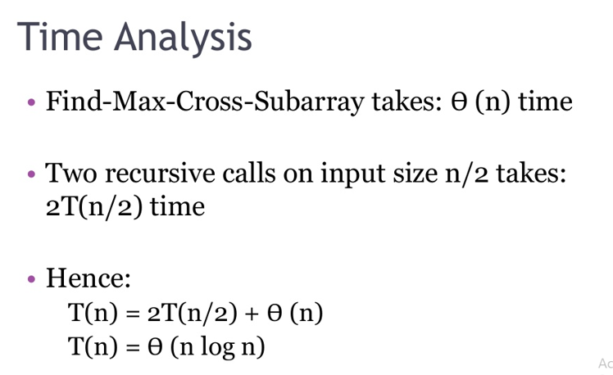
Maximum Sub Array Problem

Slide 17
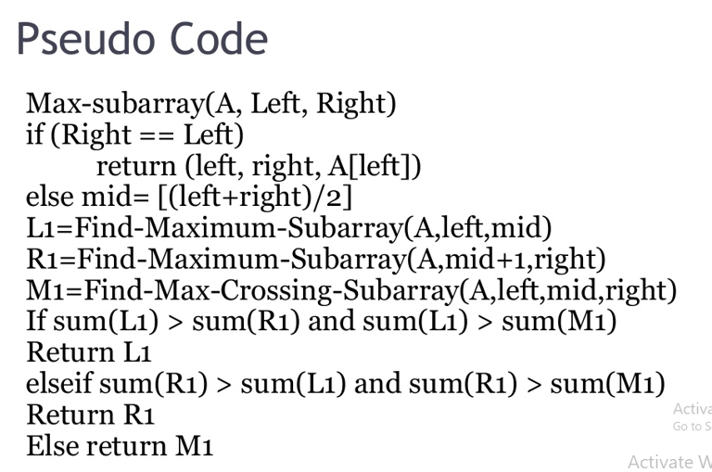
Maximum Sub Array Problem

Slide 18
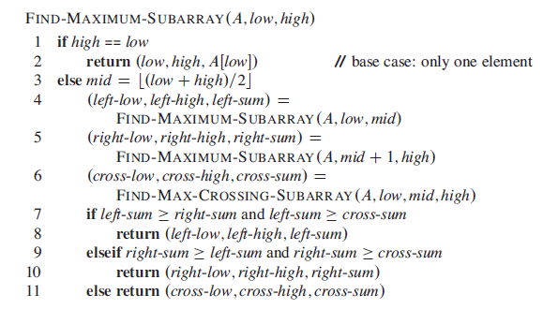
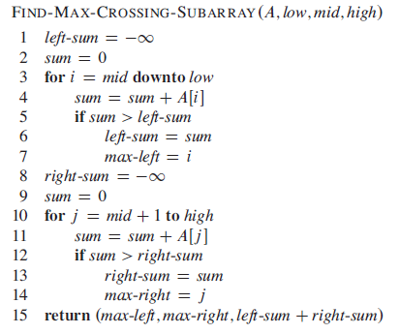
Maximum Sub Array Problem

Slide 19
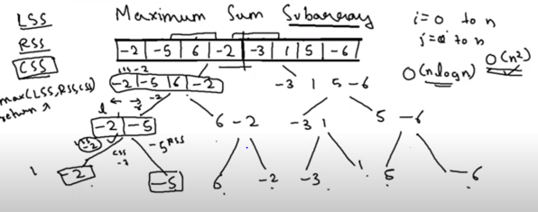
Maximum Sub Array Problem
Working of this algorithm was elaborated in class.
Those who were absent, watch below link to understand working of maximum sub array that follows divide and conquer code. Below diagram is from this link as well.
https://www.youtube.com/watch?v=3GD-3UZGsVI
There is one mistake in this youtube video. Also read the video description below video where he told you where he made the mistake. In case of any query, come to me.

Slide 20
Maximum Sub Array Problem
So this is the solution of max sub array problem in O(nlogn)
Maximum subarray algorithm is available in O(n) time as well.
Try to make it in O(n) time. Challenge yourself with out looking for the solution on internet.
Also make sure that you can solve this problem in O(n^2) time as well which is easier than O(n) and O(nlogn).

